Slide 1
Going beyond the FPGA with Spacetime
FPL 2012
Oslo, Norway
August 31, 2012
Notes:
1

Slide 2
Programmable devices: good news and bad news
The good news
  Programmable!
  On leading-edge process node
The bad news
  Very expensive!
  Very large!
  Very slow!
  Very power-hungry!
  Very hard to program (vs. CPU)!
  Controlled by a duopoly
How can we build something better than an FPGA?

Slide 3
FPGA → 3PLD
t
2.5 ns
L1
L2
2 ns
1.5 ns
y
1 ns
L2
0.5 ns
y
1 ns
L1
L2
L1
x
x

Slide 4
FPGA → 3PLD
t
2.5 ns
2 ns
z
L4
1.5 ns
y
1 ns
L2
L4
0.5 ns
y
1 ns
L2
L1
L2
L3
L1
L3!
x
x

Slide 5
FPGA → 3PLD
L
L
L
L
L
L
L
L
L
L
L
L
L
L
L
L
L
L
L
L
L
L
z
L
L
L
L4
L
L
L
L
L
L
L
L
L
L
L
L
L
L
L
y
L
L
L
L
L
L2
L
L
L
L
L
L
L4
L
L
L
L
L
L
L
L
L
L
L
L
y
L
L
L
L
L
L
L
1 ns
L
L
L
L
L
L
L
L
L
L
L1
L2
L
L3
L1
L3!
x
x

Slide 6

Dimension is a well-defined mathematical term
Wikipedia: “the dimension of a space or object is […] the minimum number of coordinates needed to specify any point within it.”
Each LUT in Spacetime requires 3 coordinates to identify uniquely
  I.e., (x,y,t), which can also be represented as (x,y,z)
Thus, Spacetime is 3-dimensional – literally
  Not “virtually”!
FPGAs have only one layer of LUTs: they are 2-D
  Like ASICs, they have many layers of interconnect
Each LUT in an interposer-enhanced FPGA can still be uniquely identified by two coordinates: (x,y)
  The interposer just adds more layers of interconnect
Thus, interposer-enhanced FPGAs are also 2-dimensional

Slide 7
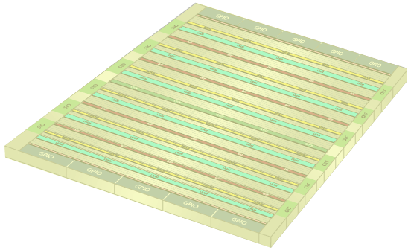
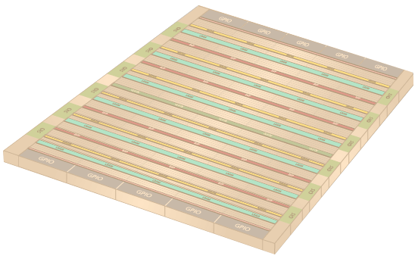
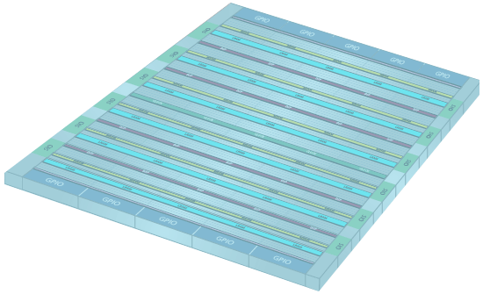
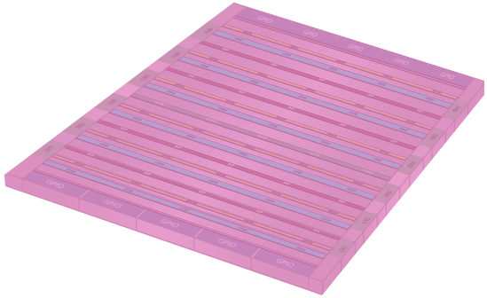
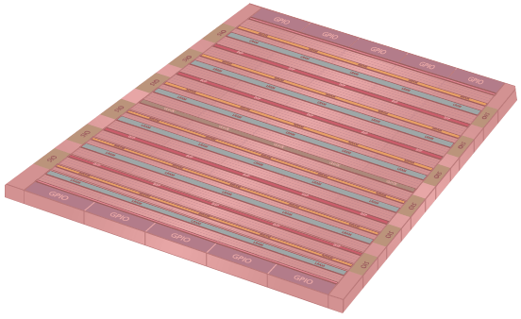
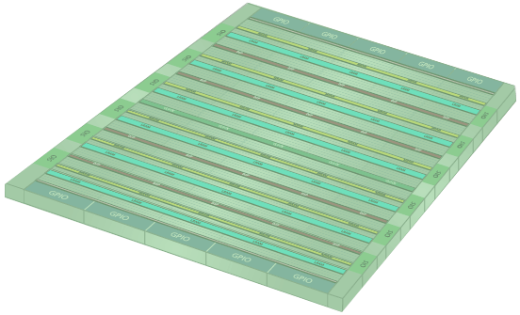
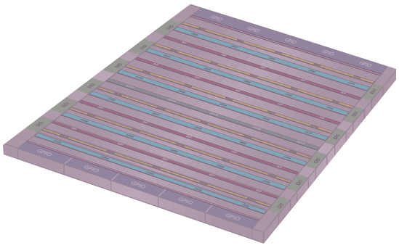
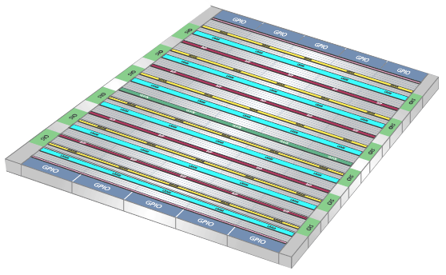
Implementing the third dimension in Spacetime
z
11
11
10
10
9
9
8
8
7
7
6
12 folds
6
5
5
4
x
4
3
3
2
2
1
1
0
y
0
0
1
2
3
4
5
6
7
8
9
10
11
2.0 GHz clock
166 MHz
user clock
Notes:
7

Slide 8
A very small sample of the interesting problems
How can you close timing?
Can you achieve high performance?
Doesn’t the time to reconfigure kill you?
Where does the state go during reconfiguration?
How do you map designs to this fabric?
Do you have to design differently for such an architecture?
Interaction between asynchronous domains
How do memories work?
Isn’t the power awful?
Can you build an analytical placer in Spacetime?
Interaction between related clock domains
What does the router look like?
How do you compute minimal spanning trees?
How do you compute Steiner trees?
How do you account for the reconfiguration time in timing-driven P&R?
How is logic synthesis affected by Spacetime?
What does clock gating look like in Spacetime?
How does DSP work?
This talk

Slide 9
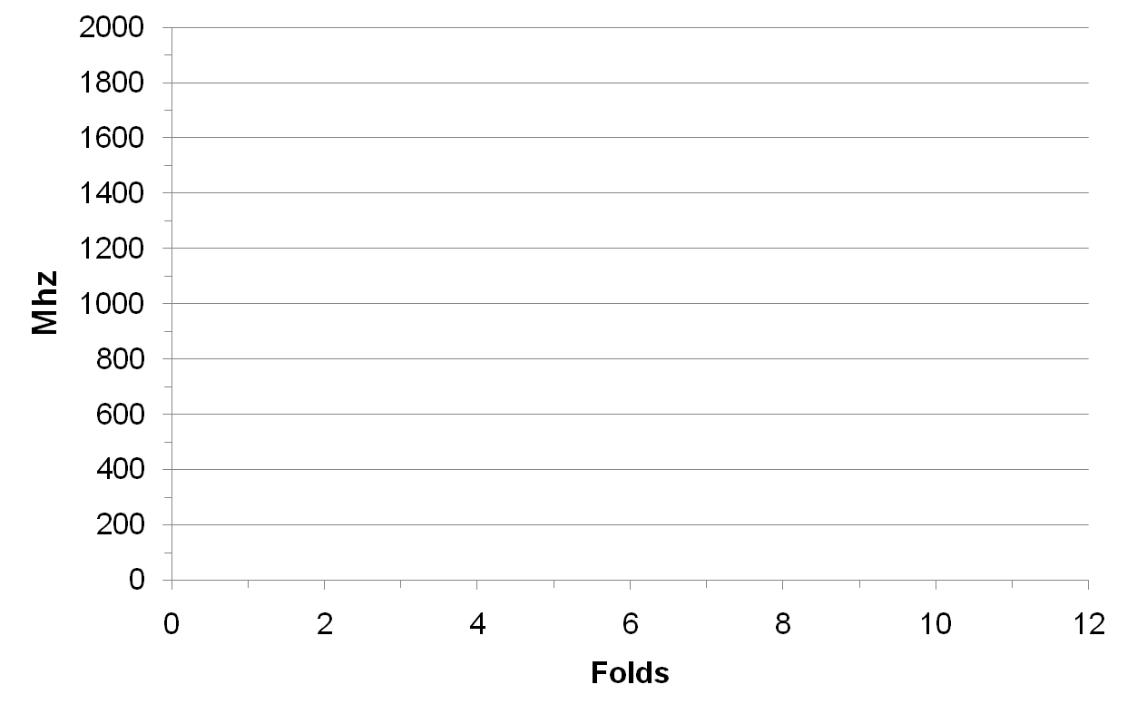


Some logic must be fast, but most logic can be slow
2 GHz
(DSP)
500 MHz
(ASSP Datapath)
150-200 MHz
(Control, soft μP)
ABAX
MHz
250 MHz
(FPGA Datapath)
FPGA
Stylus™ software automatically co-optimizes space and time
© 2012 Tabula

Slide 10
Spacetime memories
RAM
Z
(Time)
Folds
Logic and interconnect
Y
RAM circuits
X
© 2012 Tabula

Slide 11
Spacetime memories are fast and have lots of ports
Z
(Time)
…
Fold 4
Fold 3
Fold 2
Fold 1
Y
Fold 0
X
Stylus infers multi-ported memories automatically from RTL
© 2012 Tabula

Slide 12
Spacetime memories
Spacetime memories can use single-ported RAM cells
  Half the size of the dual-ported RAM cells in FPGAs
2 GHz throughput – faster than most ASICs
  2 GHz in practice → >3x faster than dual-ported FPGA memory
  Great for 100 Gbps networking
12 different pieces of logic can be adjacent to the same memory!
  Very low latency
DSPs can be fed at 2 GHz
  ➔ DSPs can run at 2 GHz in practice
Multiple user memories can be “folded” into one Spacetime memory
  Non-overlapping bits in space
  Non-overlapping ports in time
So, multiple pieces of logic can be simultaneously adjacent to multiple memories!

Slide 13
Programmable devices are about interconnect
Interconnect
250-300
MHz
Interconnect
250-300
MHz
Interconnect
250-300
MHz
Interconnect
250-300
MHz
Logic
250-300 MHz
RAM
400-500 MHz
RAM
400-500 MHz
Transceivers
10 GHz+
Transceivers
10 GHz+
FPGA performance bogged down by long wires (= slow interconnect)
© 2012 Tabula

Slide 14
Spacetime addresses the interconnect bottleneck
Interconnect
2,000 MHz
RAM
2,000 MHz
Interconnect
2,000 MHz
Logic
2,000 MHz
Interconnect
2,000 MHz
RAM
2,000 MHz
Interconnect
2,000 MHz
Transceivers
10 GHz+
Transceivers
10 GHz+
Everything can run at 2 GHz on our chips
© 2012 Tabula

Slide 15
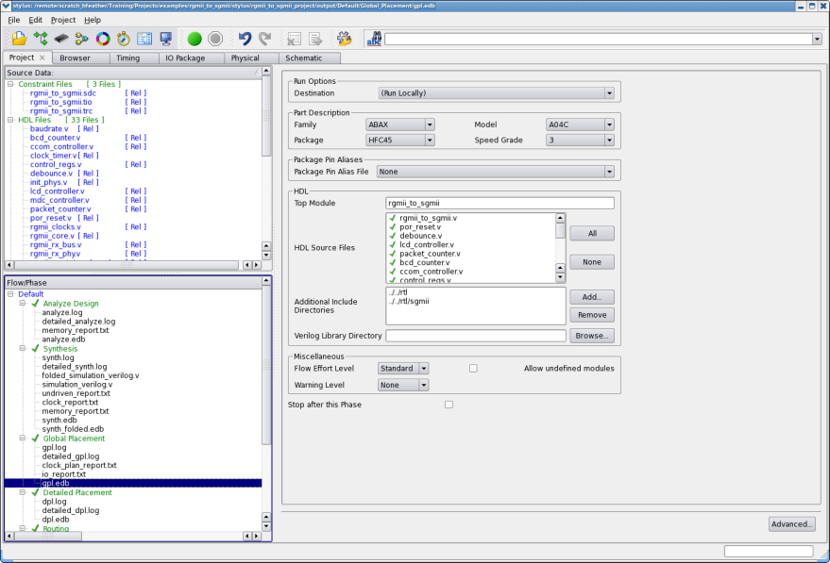
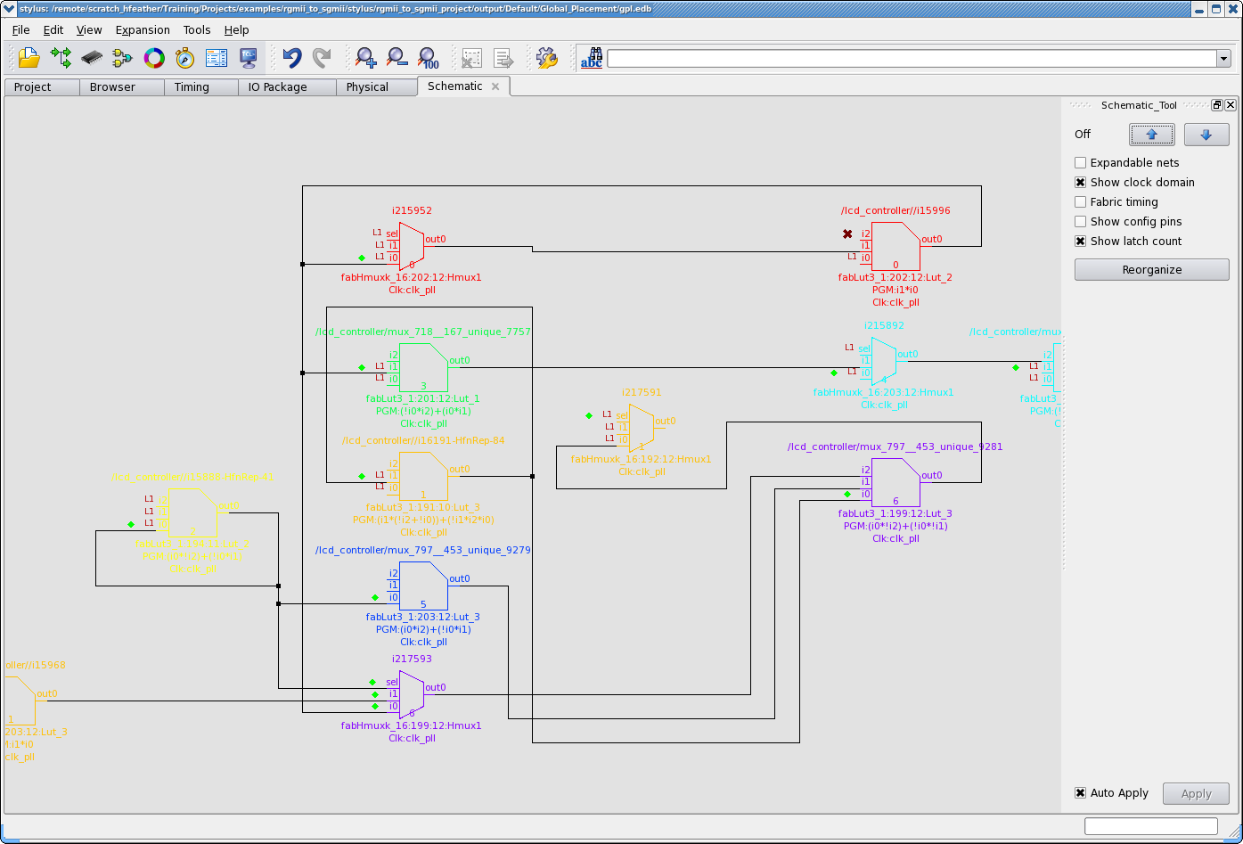
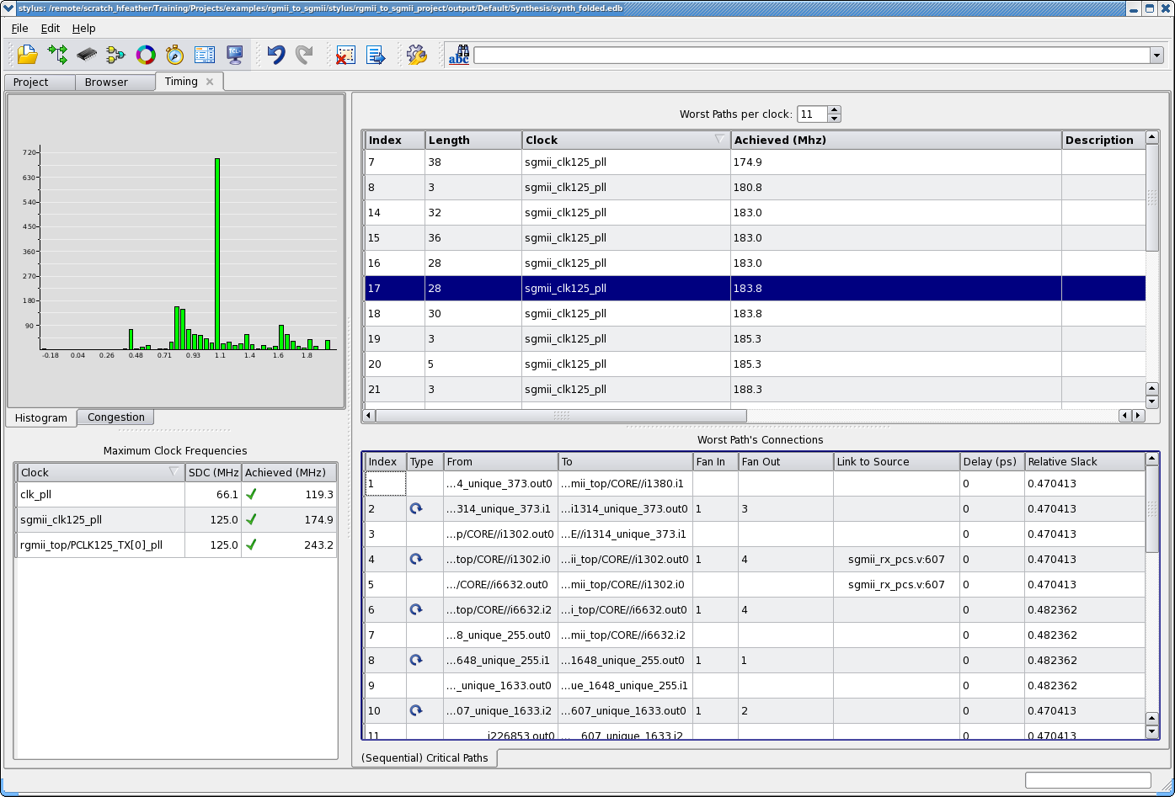
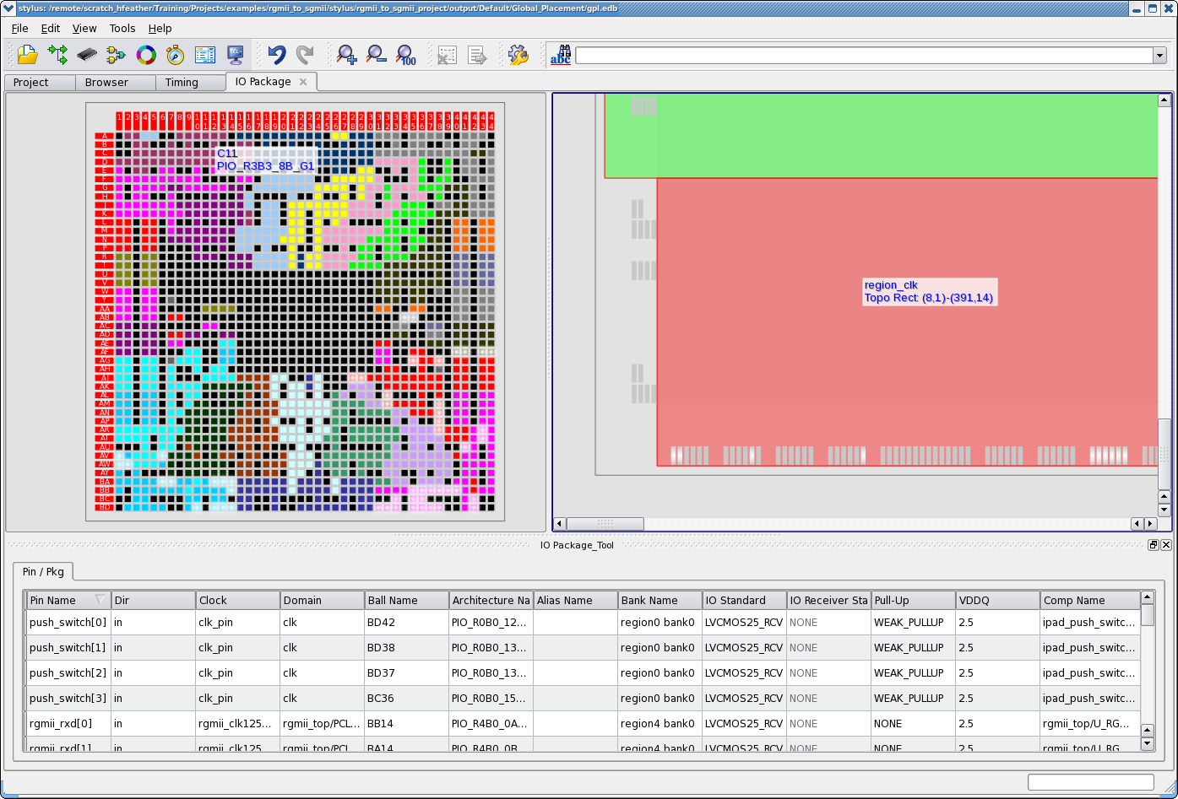
Stylus: integrated design system
Completely integrated design environment
  Project management
  HDL and Schematic browsing
  Timing analysis and correlation back to HDL
  I/O Pin and Board planning
  …
© 2012 Tabula

Slide 16
Achieving high performance with Spacetime
Time
Speed of light!
0
1
2
3
4
5
In the interconnect!
Quantization into small subcycles completely gates the performance of a dynamically reconfigurable device
  It isn’t the reconfiguration time itself…
No pre-Spacetime, reconfigurable device could have achieved high performance
  No one before us even noticed the problem!
Transparent latch!
Wasted time!
Space

Slide 17
Achieving high performance with Spacetime
Time
Speed of light!
0
1
2
3
4
5
Most “extension” is in interconnect – cheap!
Can reuse almost everything almost always
Can run at the full rate of the underlying circuits
Wires are much shorter than spatial
  Because of 3-D!
  Shorter by O(√n): ~3x
Space

Slide 18
Advanced Spacetime technique: extension
Used pervasively by Spacetime P&R to optimize timing
  Hides subcycle boundaries; treats time as continuous
  Local reduction in foldedness of design
  Removes quantization effects and reconfiguration timing ‘tax’
Allows design to run at maximum foldedness
  More folds is always better
Vital for high-performance, reconfigurable computing
© 2012 Tabula

Slide 19
Sequential timing: much easier timing closure
Input
Output
A
B
C
D
E
F
time
11
Output
Input
Output
B
A
B
C
D
E
F
D
Makes it much easier for Stylus to close timing
Tells the user where the real timing problems are
Makes it much easier for the user to close timing
E
2
A
F
1
C
0
Input

Slide 20
Sequential timing and rescheduling
User state elements are simply a convenient way to name values
  E.g., “the one that showed up here last time” vs. “… this time”
Their meaning is just “a wire in Z” in Spacetime
Must still meet externally visible timing requirements, but…
Have tremendous flexibility to reschedule operations
  To optimize area, performance, and power
Spacetime enables very fine resolution of time
  E.g., 500 ps folds vs. 5 ns cycles
Rescheduling is as powerful as retiming, but it is not retiming
Does not change netlist or ordering: preserves simulation behavior!
  Can preserve user’s notion of state (and names!)
P.S., “parallel” computing is not about parallelism….
It’s about rescheduling computations while preserving correctness

Slide 21
Achieving really high performance
Reduce folds per cycle, and rescale
Z resource increases quadratically with rescaling
Easier timing closure
Improved routability
2
12-loopered
1
2000 ps = 500 MHz
4-folded
0
4-loopered
500 ps

Slide 22
…and merging domains for better P&R
2
500 MHz
166 MHz
1
0

Slide 23
Mapping designs to Spacetime
Objective: “Hide the Revolution”
  Support traditional design methodology with RTL and SDC
  Automatically map the designs to Spacetime (as though to ASIC or FPGA)
Key observation: view the chip as 3-D!
  Do not separate spatial placement from temporal scheduling
  Do timing-driven placement in 3-D
Spacetime geometry is Minkowski – not Euclidean or Manhattan
  Component’s sinks must be in its light cone

Slide 24
Minkowski’s spacetime in two dimensions
t – α|x| ≥ 0
t
Causality is possible
“Speed of light”
Causality is impossible
Causality is impossible
B
A
x
© 2012 Tabula

Slide 25
Minkowski spacetime in three dimensions
t
Δt
y
Δ(x,y)
t – α|x| - β|y| ≥ 0
x
© 2012 Tabula

Slide 26

Minkowski spacetime in three dimensions, cont.
t
y
x
© 2012 Tabula

Slide 27


Spacetime cones live on a torus
2
3
1
t (= z)
4
0
5
6
7
© 2012 Tabula

Slide 28
Managing asynchronous clock domains
Designs with multiple, unrelated clock domains are ubiquitous
  I/O standards
  IP
  Debug/monitoring module
Need a way to transmit data between domains
Problem: metastability!
  Unavoidable
Mitigation strategy: time
  Longer wait time → reduced probability of metastability
Three common implementation strategies in non-Spacetime parts
  Asynchronous FIFO
  Dual-clocked RAM
  Chain of state elements (e.g., flops)

Slide 29
Managing asynchronous domains in Spacetime
Asynchronous FIFO
  Hard asynchronous FIFO in every SerDes and every Parallel I/O
  Pushes much asynchrony “to the boundary”
Dual-clocked RAM
  Many dual-clocked RAMs
  When single-clocked, act as dual-ported per subcycle
Chain of state elements (e.g., flops)
  Need to wait for τ ns
  On a spatial part, wait time is in quanta of user cycles (e.g., 3.5 – 6 ns)
  In Spacetime, quantum is duration of fold – e.g., 500 ps
Thus, latency of asynchronous communication can be much lower in Spacetime
Advanced: ratiochronous domains can often implement asynchronous domains

Slide 30
Power
There are four components to Spacetime power
  Static / Leakage
  Dynamic / “User”
  I/O
  Reconfiguration
Spacetime can offer much lower leakage power
  ~1/3 the die area of FPGA for a given function
  Leakage is becoming dominant at advanced process nodes
Spacetime can offer somewhat lower dynamic power!

Slide 31
Dynamic power is lower with Spacetime
LUT
1.6 GHz
LUT
1.6 GHz
LUT
1.6 GHz
LUT
Same amount of work in the same amount of time
Same amount of dynamic power
But…
Our wires are much shorter: factor of O(√n)
Thus, Spacetime dynamic power can be lower than the FPGA’s ☺
LUT
1 physical LUT at 1.6 GHz
Running 8 programs in 5 ns
1.6 GHz
LUT
1.6 GHz
LUT
1.6 GHz
LUT
1.6 GHz
LUT
1.6 GHz
LUT
LUT
LUT
LUT
LUT
LUT
LUT
LUT
Xitera FPGA:
8 LUTs at 200 MHz
8 programs in 5 ns

Slide 32
Power
There are four components to Spacetime power
  Static / Leakage
  Dynamic / “User”
  I/O
  Reconfiguration
Spacetime can offer much lower leakage power
  ~1/3 the die area of FPGA for a given function
  Leakage is becoming dominant at advanced process nodes
Spacetime can offer somewhat lower dynamic power!
Spacetime offers roughly equal I/O power
Spacetime must (uniquely) pay a reconfiguration tax
Horse race between leakage + dynamic and reconfiguration

Slide 33
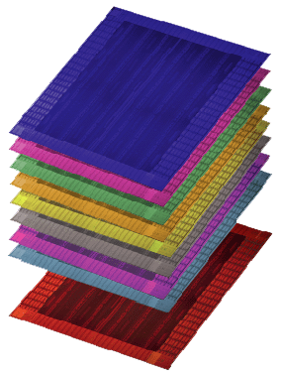



A new category of programmable device
FPGA
Tabula 3PLD
6.0
3.7
3.0
2.5
2.0
2.5x LOGIC DENSITY
2x MEMORY DENSITY
3x MEMORY PORTS
4x DSP PERFORMANCE
6x LOGIC PERFORMANCE
Memory
Logic
Memory
DSP
Logic
Performance
Density
Density
Throughput
Performance
“…capability unmatched by traditional FPGAs or CPLDs.”
“…unmatched capability and affordability.”
“…can surpass performance of FPGAs or CPLDs.”
© 2012 Tabula
Notes:
With Spacetime, Tabula chips have more capability than the most powerful, thousand-dollar chips from Xilinx and Altera yet sell for $200 or less……….. Our chips have 2.5 to 3 times the logic density, more than twice as much memory, three times the memory throughput, and four times the video processing … at one-fifth the price.
This level of advancement is unprecedented in the industry

Slide 34
Summary
Spacetime dramatically improves density, performance, memory, DSP
  Need not cost extra power intrinsically
Map designs into 3D using the mathematics of special relativity
  2 spatial dimensions and 1 time dimension = 3D Minkowski spacetime
Dynamic reconfiguration is just the first step on a long, fascinating path
  Significant inventions all along the way
Many advanced Spacetime techniques
  Transparent latches in interconnect, extension, rescaling, rescheduling, state as Z wiring, P&R in 3D Minkowski geometry, etc.
Static scheduling and 3D view opens a new door in computing
Powerful, alternative perspective from “parallel computing” to exploit massive parallelism of the hardware
Wait ‘til you see what happens next!

